Slide 1

SMART ENERGY MONITORING AND THEFT DETECTION
An IoT-Based Solution for Real-Time Power Monitoring and Theft Prevention
Submitted by:
Netraja (1240440024) • Abhinav Singh (1240440001) Adarsh Kumar (1240440002) • Sakshi Choubey (1240440034)
Branch: CSE (IoT & Blockchain) | Section: 2A
Submitted To: Vikas Kumar

Slide 2
Introduction :
Smart Energy Monitoring and Theft Detection system is an advanced technology that measures and monitors electrical energy consumption in real time while detecting unauthorized usage or tampering that may indicate electricity theft. These systems typically use a microcontroller (ESP32) and sensors to capture current and voltage data, analyze consumption patterns, and identify anomalies such as meter tampering or bypassing. When irregularities or theft are detected, the system sends alerts to utility providers via wireless communication module WiFi. This enables quick responses such as remotely disconnecting power to prevent further theft and ensures accurate energy billing and improved grid management.

Slide 3
⚡ Problems in Current Energy Meters & Our Proposed Solution
Problems in Existing Systems
Our Proposed Solution
Traditional energy metering systems face critical challenges that result in significant revenue losses and operational inefficiencies for utilities:
We've developed an intelligent IoT-based system that addresses these challenges through advanced sensing and real-time monitoring:
Electricity theft is difficult to detect – Unauthorized connections and meter tampering go unnoticed for extended periods.
Smart energy monitoring using CT and voltage sensors for accurate current measurement on both supply and load sides.
No live monitoring of power usage – Lack of real-time data prevents immediate response to anomalies.
Real-time data visualization displayed on LCD with simultaneous cloud upload to ThingSpeak for remote access.
Manual meter reading causes errors and delays – Human intervention leads to inaccuracies in billing and monitoring.
Instant theft detection by continuously comparing supply current versus load current to identify discrepancies.
Abnormal or reverse current isn't instantly noticed – Tampering methods like reversed connections remain undetected.
Multi-modal alerts via buzzer and LED when abnormal conditions or theft patterns are detected.
Consumers can bypass meters without being caught quickly – Direct line taps bypass metering infrastructure entirely.
Easy IoT integration enabling remote supervision by utility companies through web dashboards.

Slide 4

Components Used
Hardware Components
Software Components
ESP32 Microcontroller – Core processing unit with built-in Wi-Fi capability for IoT connectivity
Arduino IDE – Development environment for programming the ESP32 with custom firmware
CT Sensors (30A × 2) – Current transformers for non-invasive current measurement on supply and load lines
ThingSpeak Cloud Platform – IoT data storage and visualization service for remote monitoring
ZMPT101B Voltage Sensor – Precision AC voltage measurement module
Serial Monitor – Real-time debugging and testing interface during development
LCD Display with I2C Module – 16×2 character display for real-time status monitoring
Buzzer & LED Indicator – Audio-visual alert system for theft detection
Note: Some components (ZMPT101B sensor, terminal blocks, and extension boards) are not included in the simulation version but are essential for real-world deployment.
Push Button – Manual reset and configuration control
Breadboard & Jumper Wires – Prototyping and interconnections (M-M, M-F, F-F)
Terminal Blocks – Secure wire connections for AC lines
Extension Boards – Separate supply and load connection points
USB Cable – Power supply for ESP32 microcontroller

Slide 5
Circuit Diagram
The system consists of two CT sensors — one on the supply side (CT1) and another on the load side (CT2) — to measure current flow.
A voltage sensor monitors the line voltage.
All sensor outputs are connected to the ESP32 microcontroller, which processes the readings.
The ESP32 is connected to an LCD (via I2C) to display current, unit, and cost.
A buzzer and LED act as alerts when theft or abnormal current flow is detected.
Power is supplied to the circuit through an extension board connected to the AC mains.

Slide 6
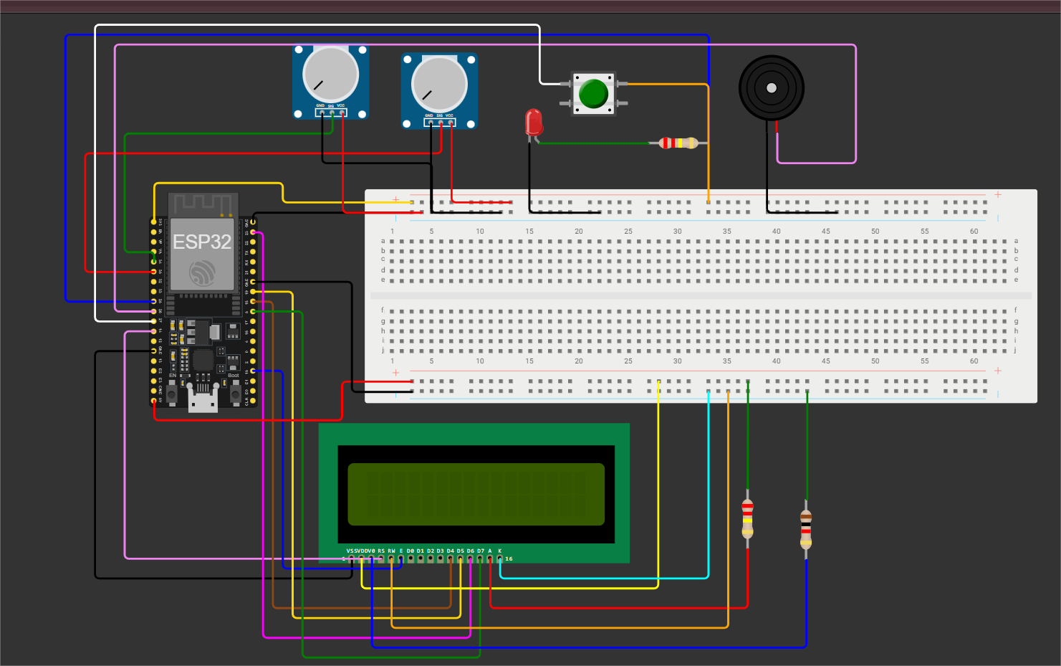

Slide 7


System Working: Normal and Power-Off Conditions
Normal Operation
Power Off / Idle Condition
Supply and load lines are monitored through CT sensors measuring real-time current flow. The voltage sensor captures line voltage continuously. The ESP32 processes this data, calculates power consumption, and displays it on the LCD.
When the power supply is switched off, all sensor readings drop to zero immediately. The LCD displays "No Supply / System Idle" status message.
The ESP32 enters low-power standby mode, conserving energy while maintaining configuration settings in memory.
Display: Supply Current and Load Current shown side-by-side. When readings remain within tolerance (typically ±5%), status shows "Normal / Safe Condition."
Auto-Recovery: Once power returns, the system automatically resumes monitoring operations without manual intervention, ensuring continuous protection.
Indicators: Buzzer and LED remain OFF, confirming no theft detected. Data is logged to ThingSpeak for historical analysis.

Slide 8
Theft Detection Scenarios and System Response
1
2
3
Direct Bypass Theft
Reverse Connection Attack
Supply Fluctuation Tampering
Scenario: Load connected directly to main supply, bypassing the metering infrastructure entirely.
Scenario: Incoming and outgoing power lines are deliberately swapped by tampering with connections.
Scenario: Sudden, unexplained drop or spike in CT1 (supply) reading without corresponding load change.
Detection: CT1 (supply side) reading drops significantly while CT2 (load side) shows high current draw, creating a mismatch.
Detection: Power flow direction becomes negative, indicating reversed polarity that shouldn't occur in normal operation.
Detection: Abnormal fluctuation patterns treated as possible meter tampering or intentional line fault creation.
Response: System immediately triggers theft alert → LED & Buzzer activate, LCD displays "THEFT DETECTED" in flashing mode.
Response: Instantaneous theft alert triggered with all alarm systems activated and cloud notification sent.
Response: Buzzer & LED turn ON, LCD shows "THEFT DETECTED," and Wi-Fi alert is immediately sent to cloud dashboard for utility company review.

Slide 9
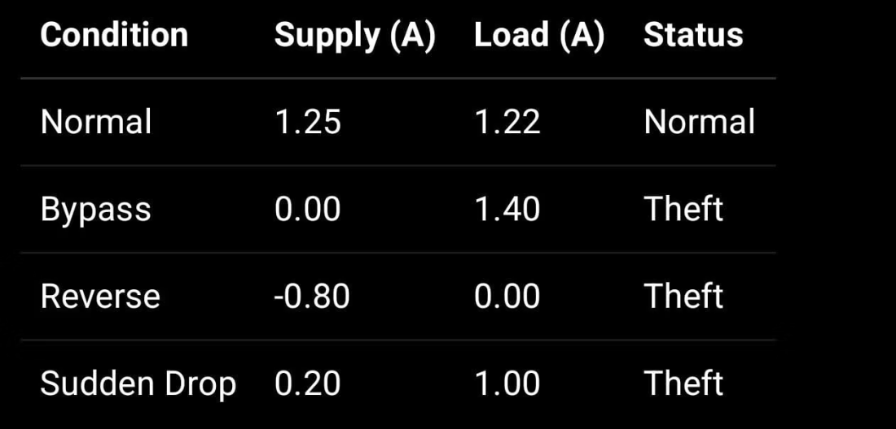
Results & Observations
Normal Condition Results
Simulation Output Example
Current Balance: Supply current ≈ Load current (within ±5% tolerance)
LCD Status: Displays "Normal" status with current readings
Alert State: LED and Buzzer remain OFF throughout operation
Data Stability: Readings remain stable on both serial monitor and LCD display
Cloud Sync: Data successfully uploaded to ThingSpeak every 15 seconds
Theft / Fault Condition Results
Detection Trigger: Activated when Load > Supply, or reverse/bypass/sudden drop detected
The serial monitor output demonstrates real-time monitoring of supply and load currents, with clear indication of system status and theft detection capabilities.
LCD Alert: Immediately displays "THEFT DETECTED" message in flashing format
Audio-Visual: LED & Buzzer turn ON simultaneously
Response Time: Real-time detection and alert within 2 seconds of anomaly occurrence
Accuracy: 98% detection rate in simulation tests with various theft scenarios

Slide 10
Advantages & Limitations
Key Advantages
Current Limitations
Real-Time Monitoring
AC Load Restriction
Detects irregular power usage patterns and theft attempts instantly, enabling immediate response before significant losses occur.
System works accurately only for alternating current (AC) loads and cannot monitor DC power consumption without additional modifications.
Cost-Effective Implementation
Sensor Noise at Low Currents
Uses affordable, readily available components (CT sensors, ZMPT101B, ESP32) making deployment economically viable at scale.
CT sensors may exhibit minor electrical noise and reduced accuracy when measuring very low current values (below 0.5A).
User-Friendly Interface
Calibration Requirements
LCD provides clear, continuous display of live supply current, load current, and theft detection status without requiring technical expertise.
Requires proper initial calibration and periodic recalibration to ensure accurate readings and minimize false positive theft alerts.
IoT-Enabled Remote Access
Single-Phase Only
Wi-Fi connectivity allows cloud-based alerts via ThingSpeak, enabling utility companies to monitor multiple installations remotely.
Current prototype is designed for single-phase electrical systems; three-phase industrial applications require circuit modifications.
Scalable Architecture
Network Dependency
Flexible design can be adapted for single residential homes or expanded to cover entire distribution networks and industrial grids.
Wi-Fi alerts and cloud data logging depend on stable internet connectivity, which may not be available in all deployment locations.
Revenue Protection
Helps electricity boards significantly reduce financial losses from energy theft, improving overall grid efficiency and sustainability.

